Slide 1

CECS 378 Section 04 Lecture will start shortly…

Slide 2
Computing Security: Principles and Practice Threat Modeling & Microsoft STRIDE February 22nd, 2021 CECS 378 – Spring 2021

Slide 3
Threat Modeling - Background
Whether building a new system or updating an existing one, you’ll want to consider how an intruder might go about attacking it.
Then build in appropriate defenses at the design and implementation stages.
These needs have led to a technique called threat modeling
Threat modeling is defined by Microsoft as…
“The methodical review of a system design or architecture to discover and correct design-level security problems.”

Slide 4
Threat Modeling - Questions
Who?
The bad guys will do a very good job of threat modeling your system
Will you spend the time?
What?
A repeatable process to find and address all threats in your product or system
When?
The earlier in the build process the better – gives you time to address and fix issues
Why?
Find problems when there is time to fix them
Deliver more secure products or better protect key systems
How? …

Slide 5
Threat Modeling - Approach
There are multiple approaches to threat modeling, and anyone who tells you their method is the only right one is mistaken!
There aren't any well-established ways to measure the quality of a threat model, and even the term "threat" is open to interpretation.
But, while we can't often prove that a given design is secure, we can learn from our mistakes and avoid repeating them.
That is the essence of threat modeling…

Slide 6
Threat Modeling - Key Steps
1 - Build a Data Flow Diagram (DFD)
Requires a visualization tool (like Microsoft Visio)
2 - Analyze the system for threats
Involve many people from various backgrounds
Attempt to receive consensus on risk ratings & likelihood
3 - Mitigate the threats
Assign each threat to an employee or group to fix
Track progress
4 - Validate the Mitigations
Determine if the mitigations have prevented the threat identified
Red Team often is engaged here

Slide 7
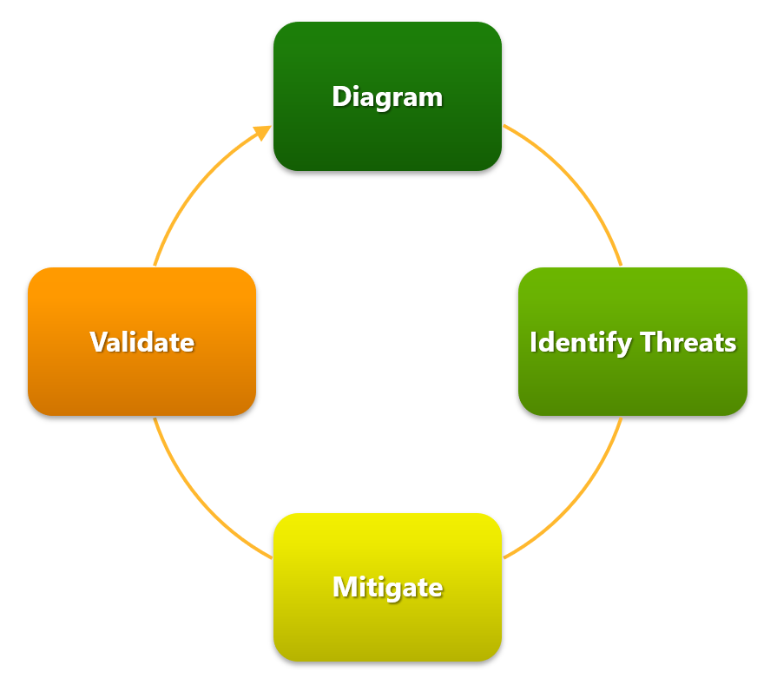
Threat Modeling - Process
Note: This is an ongoing process that continues for the lifetime of the product or system.
Note: We will call the Identify Threats step “Analyze”

Slide 8
Threat Modeling - Diagramming
Data flow diagrams (DFDs) are used to represent the system.
Decompose the system into parts and show that each part is not susceptible to relevant threats.
DFDs use a standard set of symbols consisting of the following elements: data flows, data stores, device objects, user objects, and trust boundaries.
Getting the DFD right is key to getting the threat model right.
Spend enough time on yours, making sure all pieces of system are represented.

Slide 9
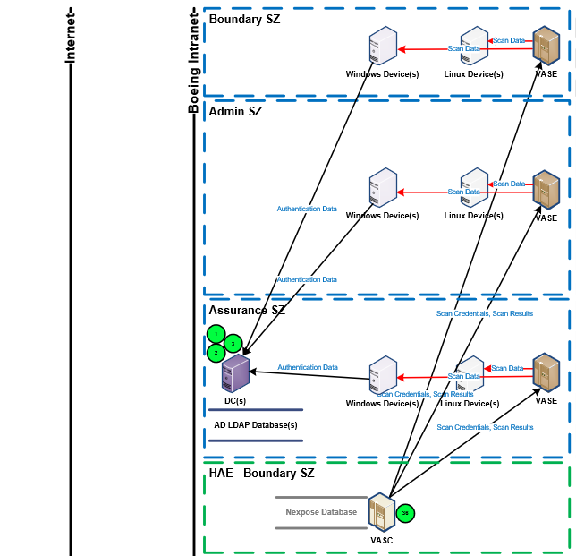
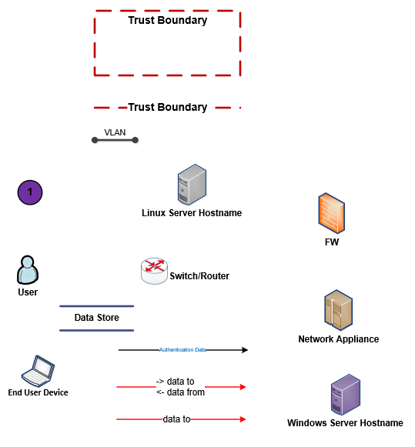
Threat Modeling - Sample Diagram

Slide 10
Threat Modeling - Analyzing
Each of the elements (data flows, data stores, device objects, user objects) has a set of threats it is susceptible to
One way to analyze your system for these threats is to ensure all items on your DFD have secure properties
One way to do that is to employ threat modeling using STRIDE which was developed by Microsoft
Rate the threat – Impact vs Likelihood
Once threats have been identified, you will need to propose mitigations for each threat

Slide 11
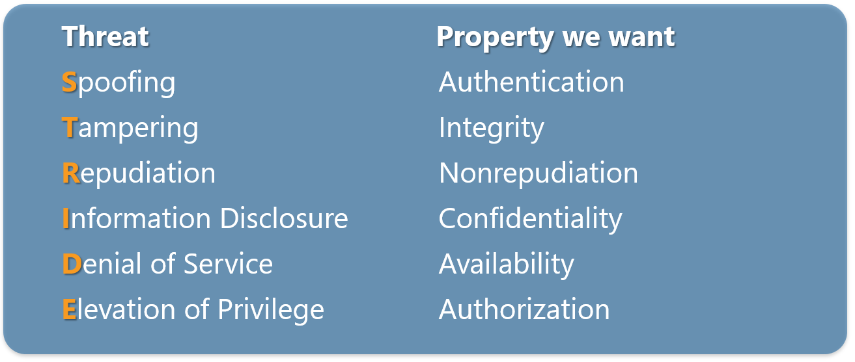
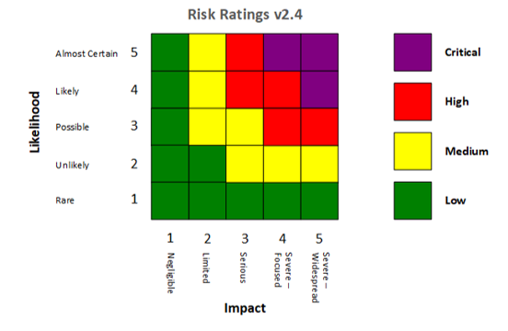
Threat Modeling - Analyzing with STRIDE

Slide 12
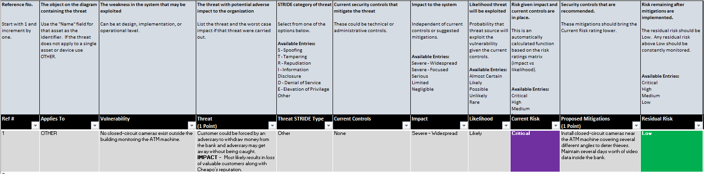
Threat Modeling - Analyzing
The deliverable coming out of the Analysis phase is the Findings Report

Slide 13
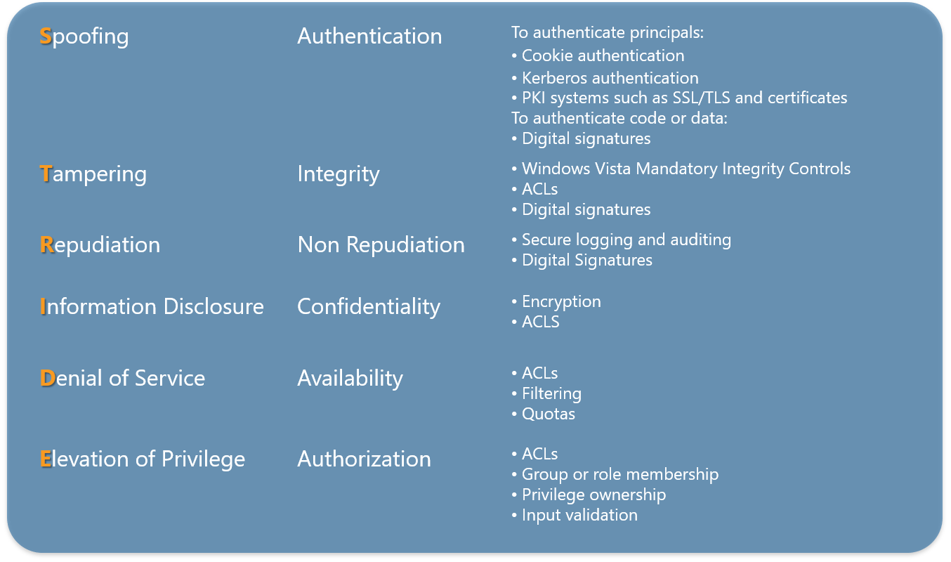
Threat Modeling - Mitigating
During Analysis step, each threat must also have mitigation(s) identified
This step is all about implementing those mitigations

Slide 14
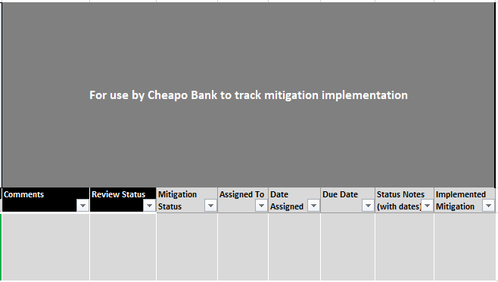
Threat Modeling - Mitigating
The mitigation work is tracked in the findings report

Slide 15
Threat Modeling - Validating
The final step in threat modeling, is validating the mitigations have addressed the threats
This may involve engaging your RED Team to “test” the mitigation(s)

Slide 16
CECS 378 Section 04 Lab has begun, if you have a question please unmute yourself and use the audio within Zoom

